Slide 1
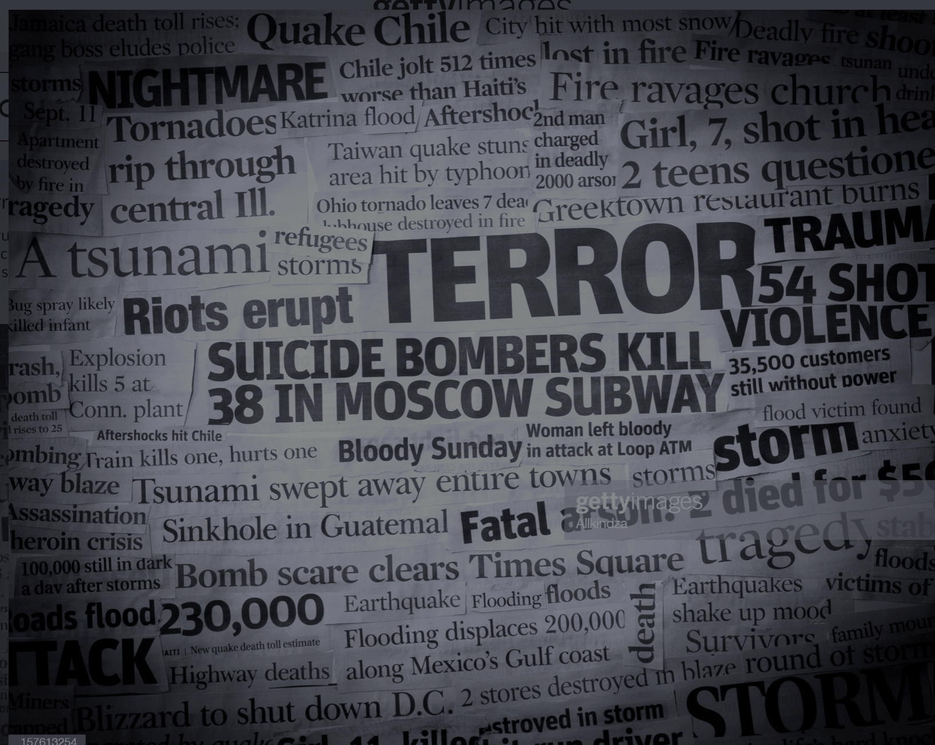
Terror & Demographics [working title]

Slide 2

Introduction:
Objectives
Goal: Understand patterns in terrorism and ascertain whether
there is correlation between demographics and terroristic activity
Ascertain which organizations caused the most deaths and injuries within the past 100 years
Understand which areas of the world suffered the most terrorist attacks in the last 100 years
Examine the common means of attack and their effects
Examine various time periods to determine which decade faced the most terrorist attacks
Survey economic information such as GDP, Credit Rating, and military expenditures to determine if there is a correlation between attacks and economic metrics
Examine demographic information such as age, gender, religion, and health indicators to determine if there is a correlation between these metrics and terrorism

Slide 3
Introduction:
Data Source
Kaggle
The World FactBook by the CIA
over 1100 columns
entry for every country
Global Terrorism Catalogue
data covers 1922 to 2022

Slide 4





Database management & Web scraping:
Tools Used:
Mongo DB
distributed team
Python-friendly
non-relational data
Python
Jupyter Notebook
Excel
NYT API

Slide 5
Database management: Cleaning
Global Terrorism Catalog:
transformed date from object to a date and extract year
transformed coordinates from object to string to create latitude and longitude columns

Slide 6
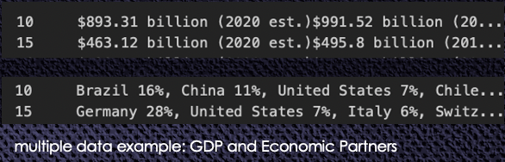
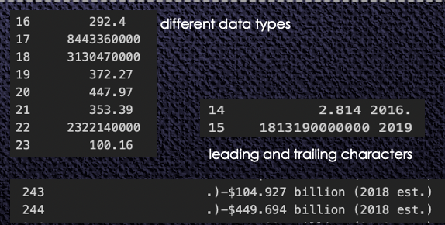
Database management: Cleaning
World Factbook by the CIA:
over 1100 columns
loaded final version shape: 258, 48
Cells contained data which needed to be separated
slicing resulted in leading and trailing characters in some instances
Excel: text to columns

Slide 7
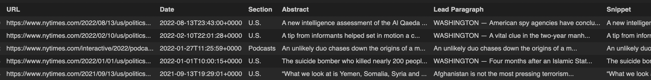
Database management: Web scraping
NYT API:
Chose API to avoid violating user terms that may exist
Scraped: URL, date, section, abstract, lead paragraph, and snippet
API feeds into a Mongo collection, the Dashboard pulls results from Mongo

Slide 8
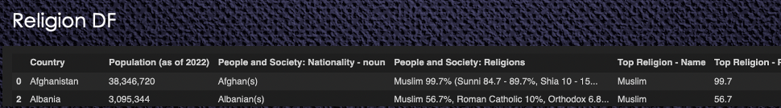
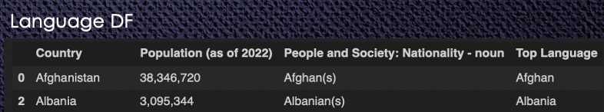
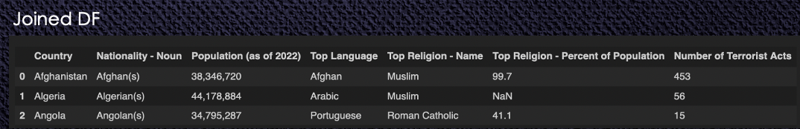
Database management: Join Data Bases & Misc.
Join Collections:
Cut 2 smaller collections from the CIA collection
Final collection comprised 3 data frames to show religion, language, and number of terrorist attacks in the last 100 years

Slide 9



Machine Learning
add text here

Slide 10
Machine Learning
add text here

Slide 11
Machine Learning
add text here

Slide 12
Machine Learning
add text here

Slide 13
Machine Learning
add text here

Slide 14
Machine Learning
add text here

Slide 15
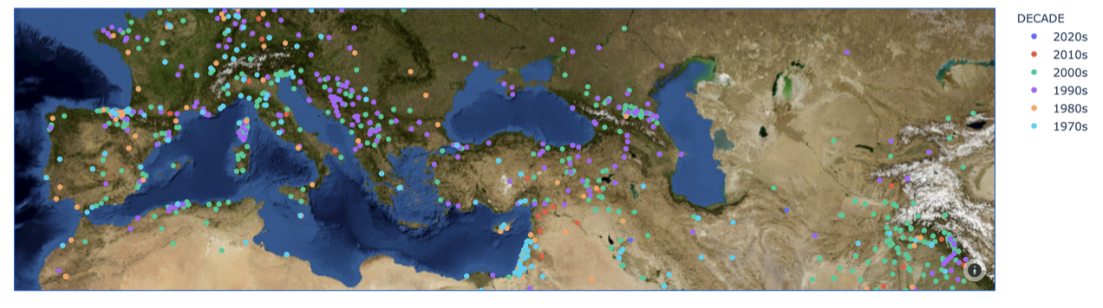



Data Visualizations Mapping with leaflet & mapbox:
create geoJSON comprised of polygons
add demographic data from the CIA Data Frame
Placeholder Map

Slide 16
Data Visualizations Charting with plotly:
worked with data frame and Ploty in Python
[code snippet]
[chart examples]

Slide 17

Data Visualizations Heroku Deployment :
[a couple notes about deployment]
[possibly code snippets]
[link to completed slides]

Slide 18
Thank you

